Slide 1

eSchool : Learning Management System
21107036: Aman Dhumal 21107053: Om D Jondhale 21107035: Pranjal Desai
21107037: Dhanashree Kasar
Project Guide
Ms. Poonam Pangarkar

Slide 2
Contents
Introduction
Objectives
Scope
Features / Functionality
Project Outcomes
Technology Stack
Block Diagram

Slide 3
1. Introduction
Eschool is an Python Based application ,which helps students to keep track of their academics .
Problem Identified :
Students need to view their attendance , grades and sometimes it can be a hassle?
Solution Proposed :
eSchool will help them view their attendance and grades in tabular format.
eSchool will also make managing students easier for staff .

Slide 4
2. Objectives
Creating a easily understandable but modern GUI .
Creating a database where admin and staff can store students information .
Adding a chat feature for students and staff to solve doubts .
Create tables for students so they can view their attendance and grades easily .
Adding a Announcement feature where Admin will be sending notices for staff and student .

Slide 5
3. Scope
Can be useful to Student for managing their studies
Can be useful to Teachers for managing students and helping them solve their doubts .
Can be useful by admin to keep track of teachers and students attendance .
Can be applied in Collages / Universities / Schools .
One can also use this application to manage private coaching classes .

Slide 6
4. Feature /Functionality
Feature 1 :
Easy access to data for student, staff and admin .
Feature 2 :
Quick text chat with anyone connected to server .
Feature 3 :
Adding features such as ( Managing attendance and grades)
Feature 4 :
Our system provides video call feature for the users. (Doubt solving, extra lecture.)

Slide 7
5. Outcome of Project
User Can Create account, Login, Change Password .
User can View Their grades and their attendance
User can also communicate with using chat .
Staff can apply for leave which will be reviewed by Admin.
Admin can remove student and staff.
staff manages the attendance of students .

Slide 8
6. Technology Stack
Front end ( GUI ) :
Python 3.11.1
CustomTkinter 5.1.2
Backend ( Database ) :
Mysql 8.0

Slide 9
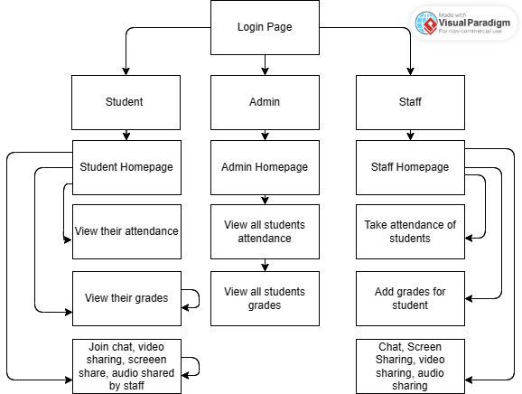
7. Block Diagram

Slide 10
Thank You...!!

